Slide 1






© 2019 Trilogy Education Services, Inc.

Slide 2

About the Data
For our Week 13 ETL assignment we chose to extract, transform and load year-over-year NYC public school attendance data. The data, provided by NYC’s Department of Education, was sourced through the NYC Open Data API. The raw dataset includes School DBN, Date and School Year; as well as the daily number of Enrolled, Present, Absent and Released students for the 2018-19 and 2019-20 school years.
The second dataset provided school names and grade levels (‘K-8,’ ‘K-12,’ etc.) corresponding to the DBN codes. This gave us a bit more context around the numbers we were working with.
Notes:
https://data.cityofnewyork.us/Education/2018-2021-Daily-Attendance-by-School/xc44-2jrh

Slide 3
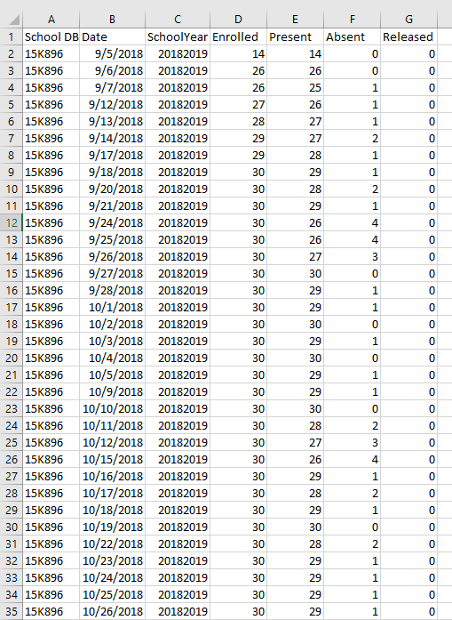
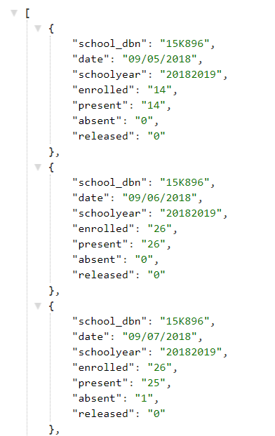
Extract
While the original dataset is in JSON format, calling the API directly limits the data returned to just 1,000 rows.
Instead we downloaded the entire dataset in CSV format from the NYC Open Data website.

Slide 4
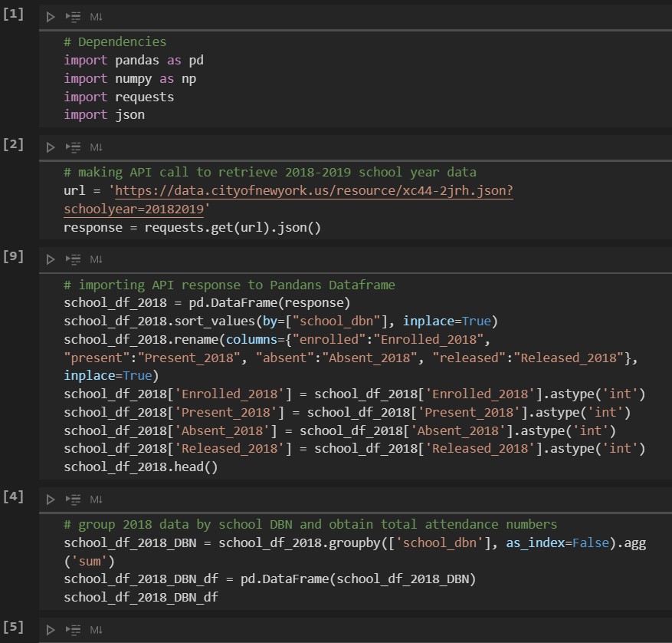
Transform
With the dataset fully accessible (450K+ rows) we can clean, group and merge the data for easier loading and analysis.
Specific transformations:
Converting numeric data types from text to integers (i.e. Enrolled, Present, Absent and Released).
Creating separate pd.DataFrames by school year for comparison
Grouping attendance data by school
Merging both school year datasets on the school_dbn value.
Merging the new consolidated table with the ‘school_name’ and ‘school_level’ dataset.

Slide 5
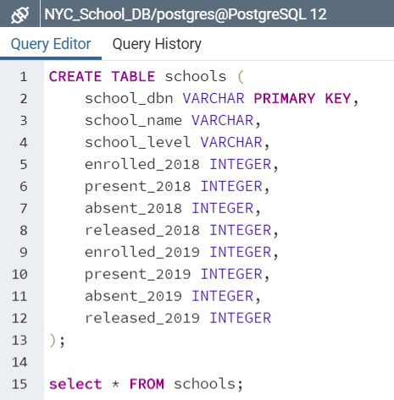
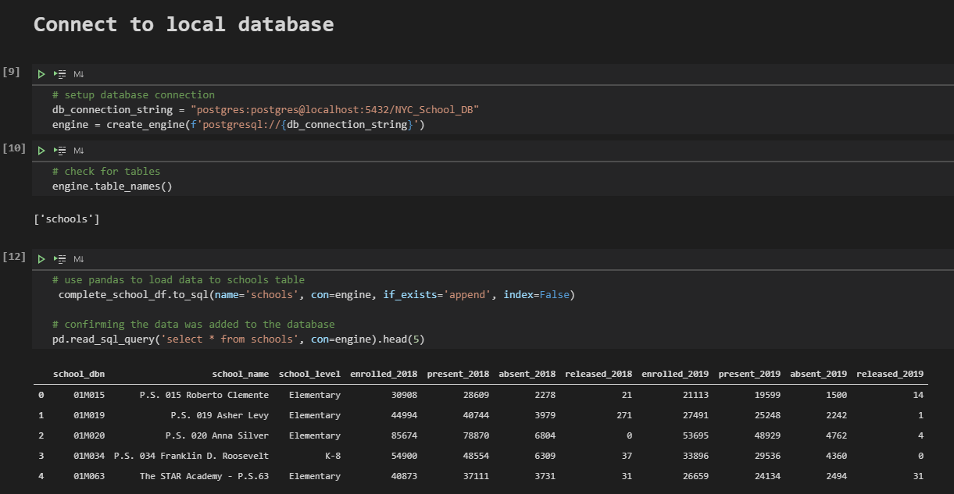
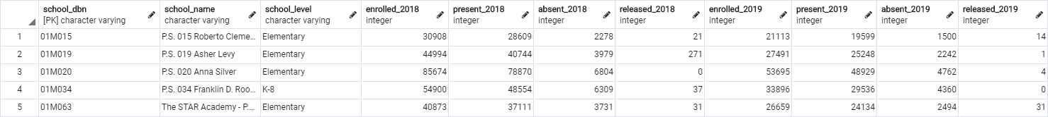
Load
Given how clean and clearly structed the dataset is, we moved the final DataFrame to a PostgreSQL relational database. This also allows for more mathematical and statistical calculations.
Load sequence:
Creating a new ‘NYC_School_DB’ database in PGAdmin and a ‘schools’ table to mirror our final pandas Dataframe
Establishing the database connection inside of our Juptyter Notebook and loading in the data
Confirming the data was loaded with the “SELECT * FROM schools” command

Slide 6
Load
1.
2.
3.

Slide 7
Further Analysis
Now that the original data has been extracted, transformed (cleaned & formatted) and loaded into a SQL database, we can easily conduct further analyses such as:
Attendance by school and/or by school year
Enrollment by school / school year
Release rate by school / school year
Additional consideration:
NYC Open Data has an additional dataset that provides school DBN codes / names as well as city borough, neighborhood, school description, course curriculum, extra curriculars and contact info.
The information above, and other relevant city datasets, can be layered on for more contextual analysis
Notes:
https://data.cityofnewyork.us/Education/2018-DOE-High-School-Directory/vw9i-7mzq

Slide 8

Questions?

